Slide 1



PATIENT COMPLAINT MANAGEMENT SYSTEM
Group 52:
Abhishek Patil 002319098
Riya Kapadnis 002347871
Shrutkeerti Sangolkar 002304742

Slide 2



PROBLEM STATEMENT
Challenges in Healthcare Systems:
Difficulty managing patient complaints and ensuring treatment accuracy.
Lack of streamlined communication between patients, healthcare professionals, and administrators.
Need for integration with drug catalogs and efficient medication management.

Slide 3
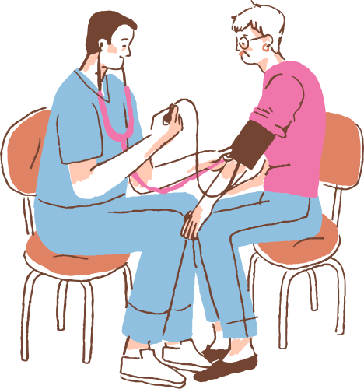
SOLUTION OVERVIEW
Proposed Solution:
A Java Swing-based Patient Complaint Management System.
Features include complaint submission, professional assessment, medication recommendations, and administrative oversight.
Integrates drug catalogs and medication management for accuracy and efficiency.

Slide 4


ADVANCED FEATURE
Emergency Services Department:
Purpose: Handle critical patient complaints requiring immediate action.
Key Features:
Dashboard for prioritizing and viewing critical complaints.
Priority handling logic based on complaint severity.
Tools for generating activity and resolution reports.

Slide 5

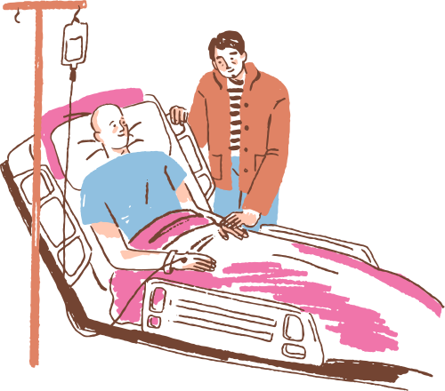
ECOSYSTEM HIERARCHY
Key Enterprises and Organizations:
Healthcare Enterprise: Emergency and Patient Services Departments.
Pharmaceutical Enterprise: Pharmacy and R&D Units.
Insurance Enterprise:
Claims Processing Unit.
Regulatory Body Enterprise: Compliance Unit.

Slide 6

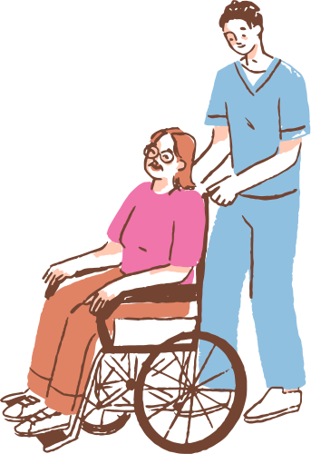
USE CASE OVERVIEW
Examples:
Submit Complaint: Patients submit health complaints and receive updates.
Pull Complaint: Professionals handle cases based on priority.
Process Medication Orders: Pharmacists verify and fulfill requests.
Generate Compliance Reports: Admins ensure regulatory adherence.

Slide 7


UML CLASS DIAGRAM
Entities:
Patient, Healthcare Professional, Admin, Pharmacist, Insurance Agent, Emergency Specialist, etc.
Relationships:
Includes aggregation (e.g., Admin oversees complaints) and associations (e.g., Healthcare Professionals handle patient complaints).
Attributes and Methods:
Attributes: complaintID, patientName, medicationID, etc.
Methods: submitComplaint(), resolveComplaint(), processClaim().

Slide 8
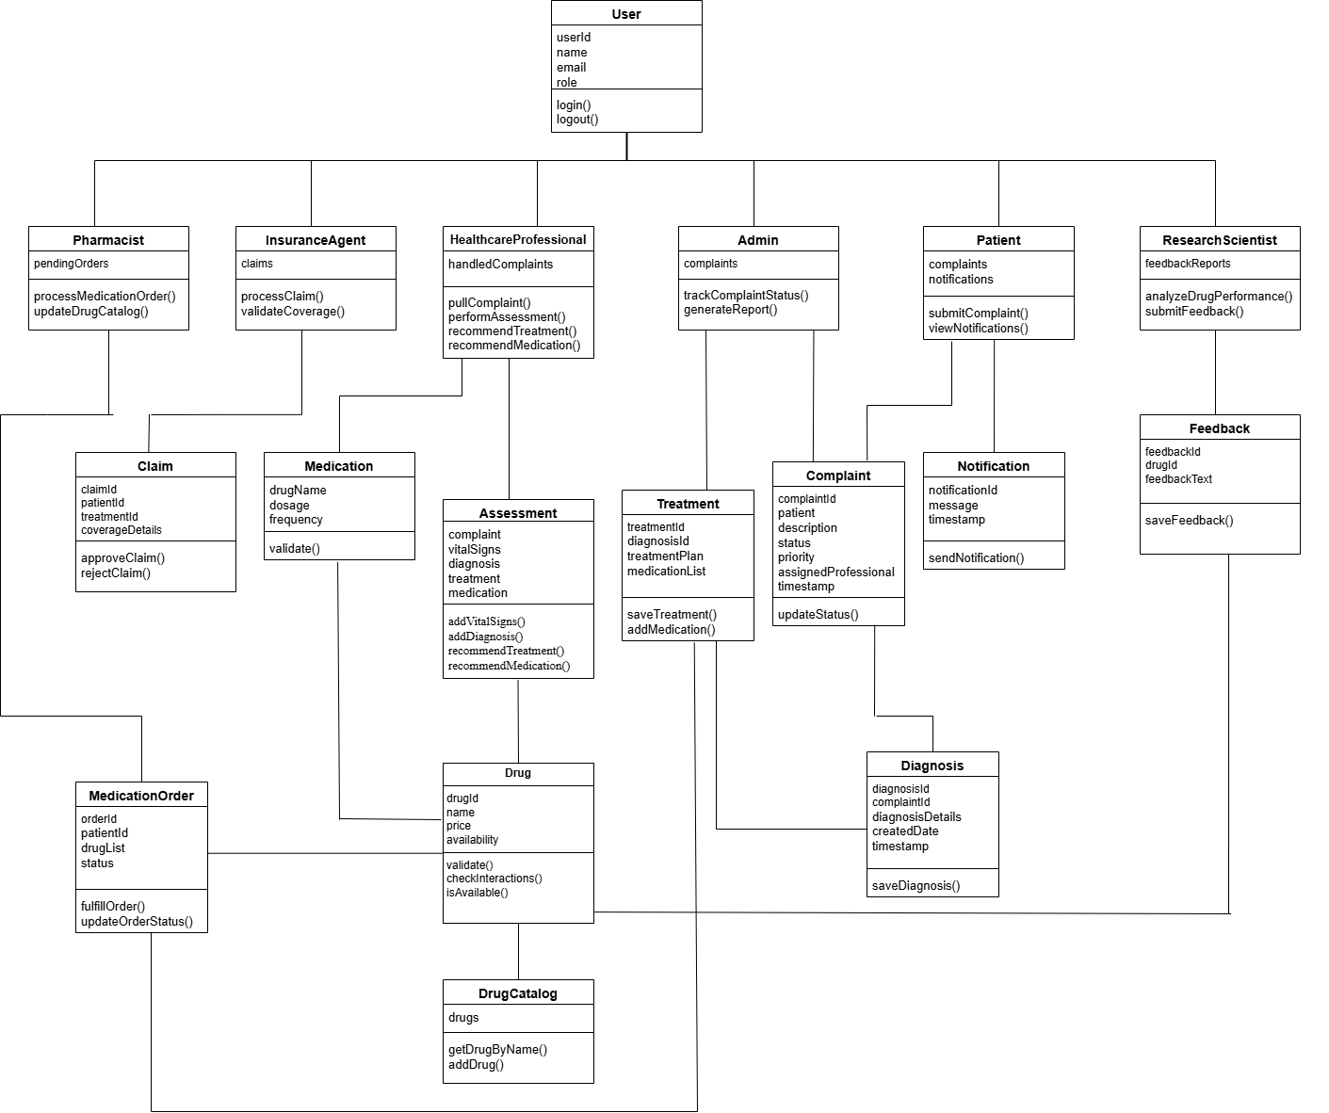
UML DIAGRAM

Slide 9

CONCLUSION
System Goals: Improve complaint management, ensure treatment accuracy, and integrate healthcare processes efficiently.
Next Steps: Implement the system and conduct testing to validate effectiveness.

Slide 10

THANK YOU !

